Slide 1
Week 2: Slides

Slide 2
“Imagine” (1971)
by John Lennon

Slide 3
[Verse 1] Imagine there's no heaven It's easy if you try No hell below us Above us, only sky Imagine all the people Living for today I [Verse 2] Imagine there's no countries It isn't hard to do Nothing to kill or die for And no religion too Imagine all the people Living life in peace You [Chorus] You may say I'm a dreamer But I'm not the only one I hope someday you'll join us And the world will be as one

Slide 4
Beyond Words
Exclamation or Ecphonesis
Using words or phrases to express emotion: ‘O’!, ‘Ah!,’ ‘Oops!’, phrases (Good god! Oops-a-daisy! Lord love a duck!), all kinds of ‘swear’ words.

Slide 5
Procatalepsis: The strategy of anticipating an opponent’s or audience’s objections and immediately answering those objections. The purpose is to strengthen one’s own argument and preempt objections from the audience.

Slide 6
Rhetoric: 3 Kinds of Persuasive Appeals
LOGOS: Appeal to logic
PATHOS: Appeal to emotions
ETHOS: Appeal to the speaker’s credibility and reputation

Slide 7
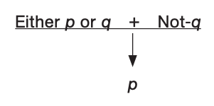
7. False Alternative

Slide 8
7. False Alternative
Either you are with us or against us.
Every citizen is either a patriot or a traitor. You are not a patriot, so you’re a traitor.

Slide 9
7. False Alternative or False Dichotomy
This fallacy involves excluding relevant possibilities without justification, so that only two choices appear viable.

Slide 10
8. False Cause: Post Hoc
“Sometimes, the sun disappears from the sky. This is because a dragon has swallowed the sun. But if we beat our magical drums, the noise will scare the dragon and it will release the sun.”
“How do you know drumming is any use?”
”Because after we beat the drums, the sun invariably reappears.”

Slide 11
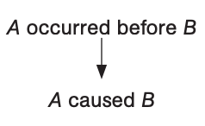
8. False Cause: Post Hoc
Post hoc, ergo propter hoc: after this, therefore because of this. This fallacy involves arguing that because event A occurred before event B, A is the cause of B.

Slide 12
8. False Cause: Post Hoc
I smiled a lot during my interview, and I got the job. Clearly, they hired me because I smiled a lot.

Slide 13
9. & 10. Hasty Generalization & Accident
Don’t go down to River Road. I was down there once and got mugged. They’re all thieves down there.
I am sure their President will be reasonable about the matter. After all, man is a rational animal.

Slide 14
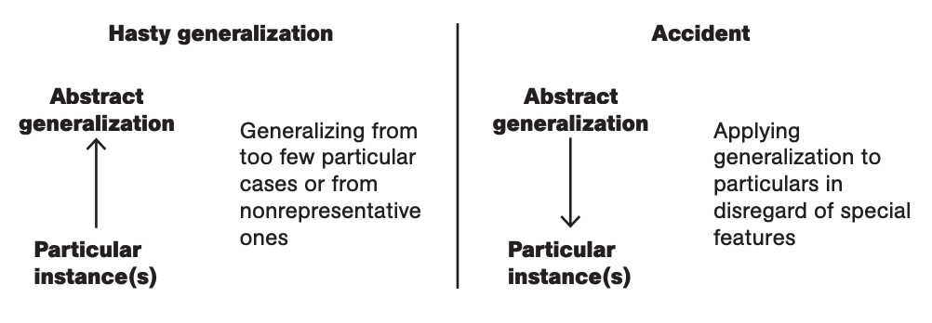
9. & 10. Hasty Generalization & Accident
‘Hasty generalization’ is also called ‘converse accident.’

Slide 15
11. Slippery Slope
We should oppose any effort by government to censor obscene books, movies, or other forms of expression, no matter how offensive we may find such material. The reason is that once government has the power to ban obscenity, that precedent will open the door to further controls on speech: banning racist remarks, then speech that the majority finds offensive, then speech that opposes government policies, and so on until no one is free to say anything without government permission.

Slide 16
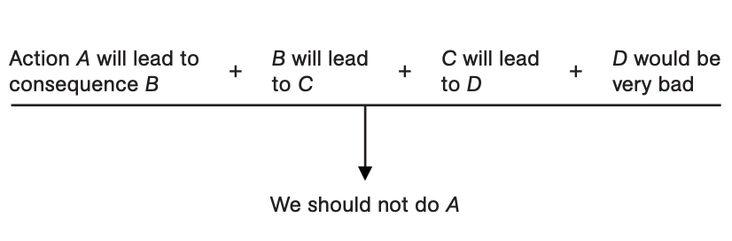
11. Slippery Slope

Slide 17
13. Begging the Question: Petitio Principii
To allow every man unbounded freedom of speech must always be, on the whole, advantageous to the state; for it is highly conducive to the interests of the community that each individual should enjoy a liberty, perfectly unlimited, of expressing his sentiments.

Slide 18
To allow every man unbounded freedom of speech must always be, on the whole, advantageous to the state; for it is highly conducive to the interests of the community that each individual should enjoy a liberty, perfectly unlimited, of expressing his sentiments.
“advantageous to the state” = “highly conducive to the interests of the community”
“allow every man unbounded freedom of speech” = “each individual should enjoy a liberty, perfectly unlimited, of expressing his sentiments”

Slide 19
13. Begging the Question: Petitio Principii
To beg the question is to assume the truth of what one seeks to prove, in the effort to prove it. The premise(s) and the conclusion tend to be identical in such cases. Such arguments are also called circular arguments.

Slide 20
Writing Resources
Useful Websites
OWL: Purdue University Online Writing Lab https://owl.purdue.edu/owl/purdue_owl.html
ACADEMIC PHRASEBANK: http://www.phrasebank.manchester.ac.uk/
Programs and Apps
Grammarly

Slide 21
Selected References
Sylva Rheoticiae: http://rhetoric.byu.edu/
Ali Almossawi. An Illustrated Book of Bad Arguments: https://bookofbadarguments.com/
Irwing M. Copi and Carl Cohen. Introduction to Logic. 9th edition. New Delhi: Prentice Hall, 1997.
David Kelley. The Art of Reasoning: An Introduction to Logic and Critical Thinking. New York: Norton, 2014.
Jay Heinrichs. Thank Your for Arguing: What Aristotle, Lincoln and Homer Simpson Can Teach Us About the Art of Persuasion. New York: The Three Rivers Press, 2007.

